Slide 1
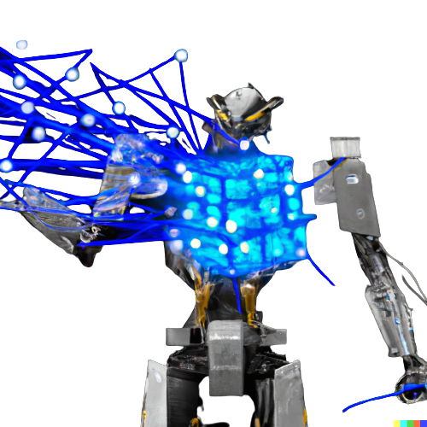

GAT Transformer
Marina Debogović
Marko Njegomir

Slide 2
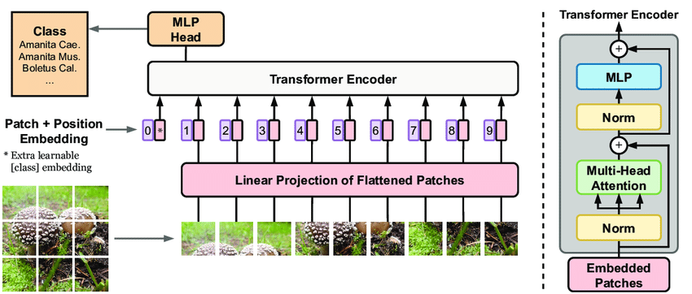
Arhitektura transformera

Slide 3
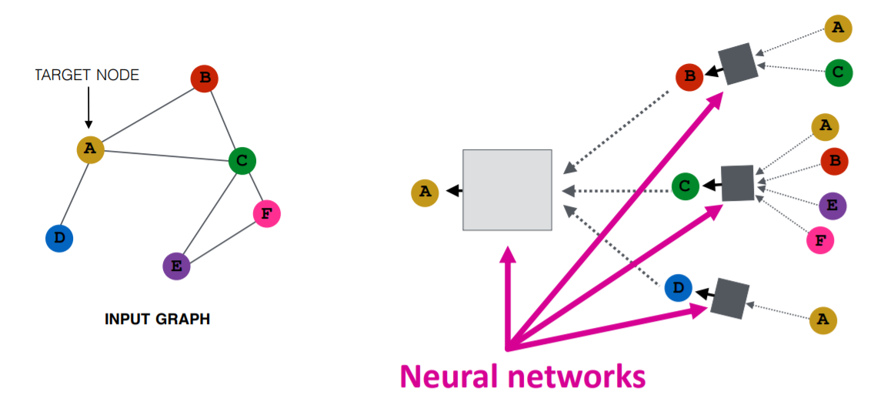
Graph attention network

Slide 4
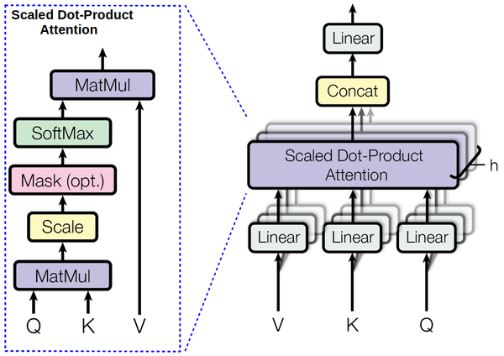





Slide 5
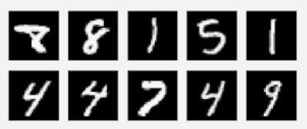
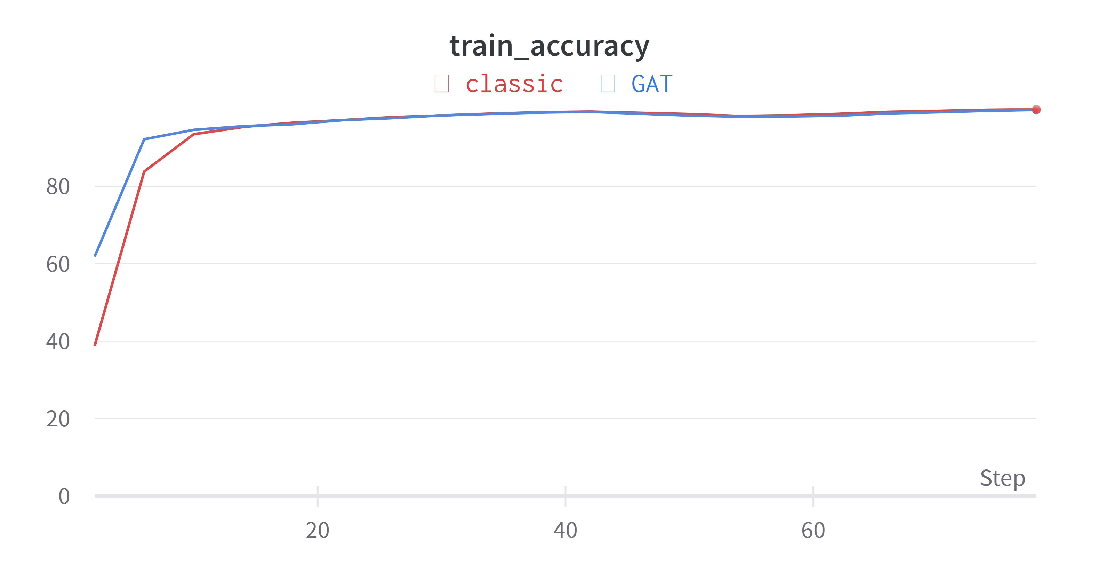
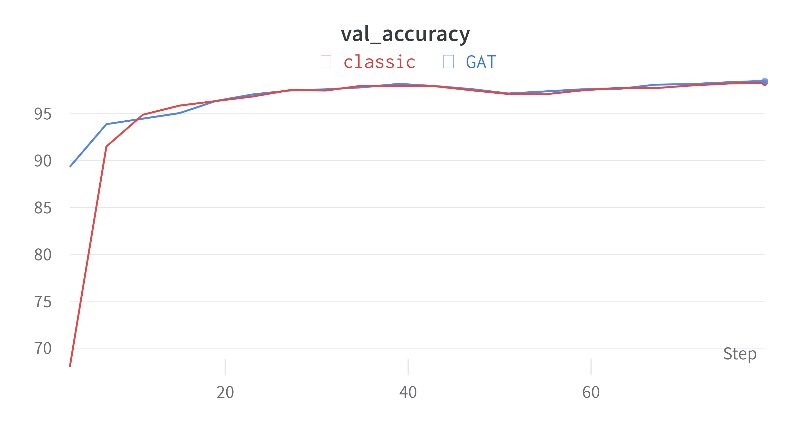
Rezultati: MNIST

Slide 6
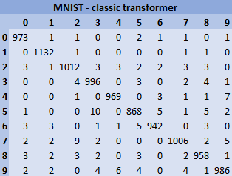
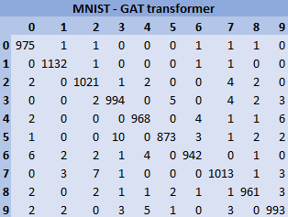
Rezultati: MNIST
MNIST - classic
Loss: | 0.0568
Accuracy: | 0.9831
Precision: | 0.98
Recall: | 0.98
MNIST - GAT
Loss: | 0.0535
Accuracy: | 0.9872
Precision: | 0.99
Recall: | 0.99

Slide 7
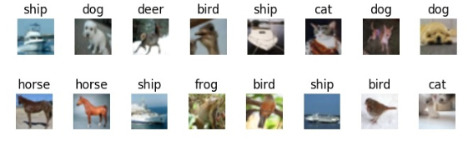
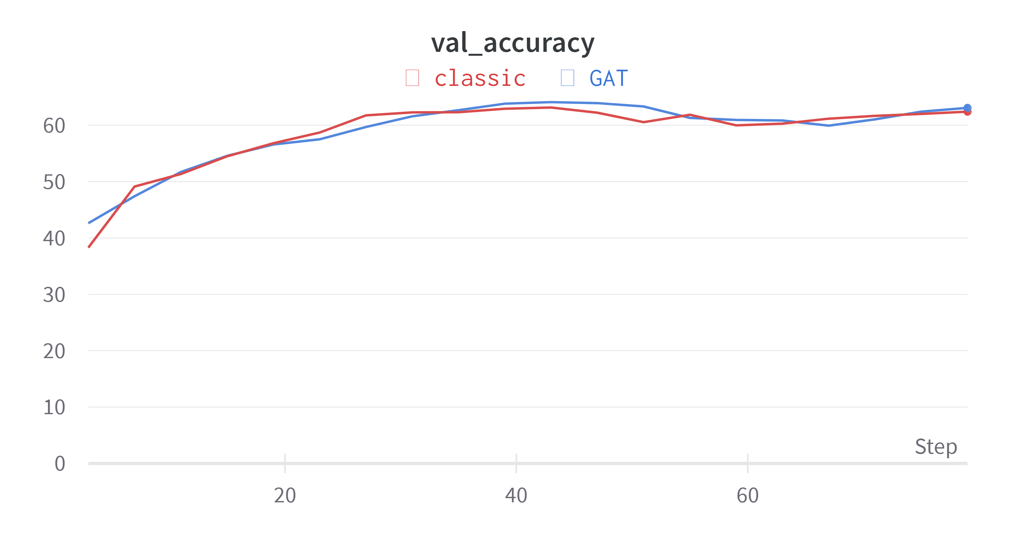
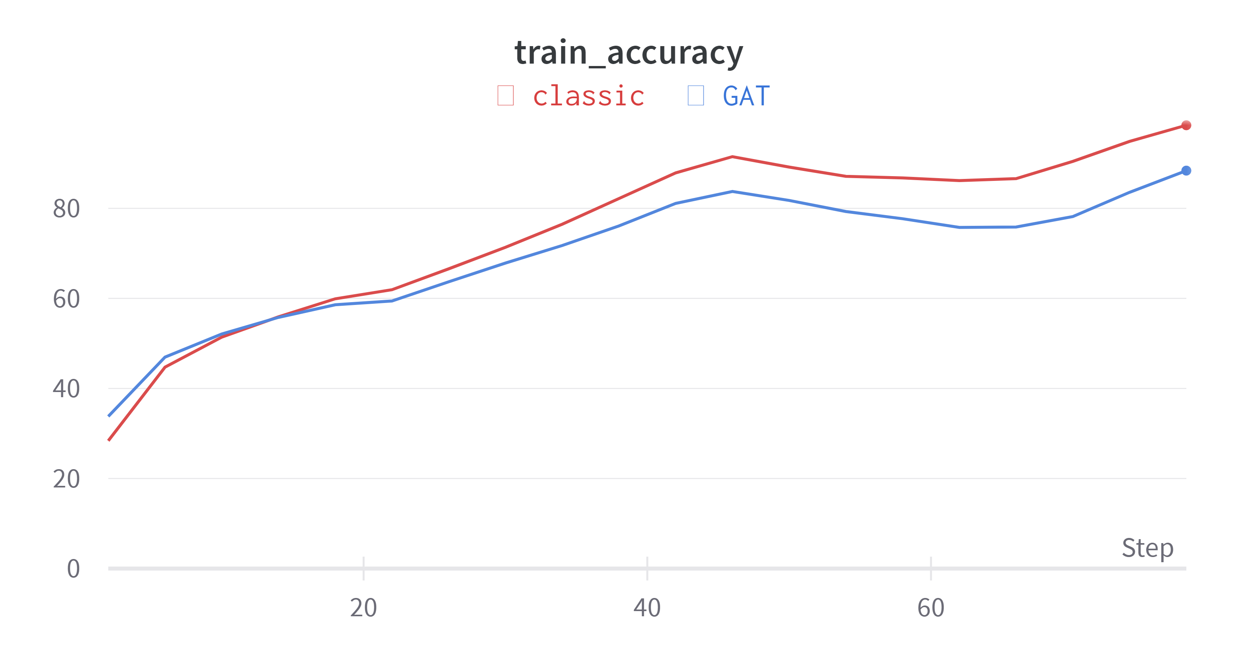
Rezultati: CIFAR10

Slide 8
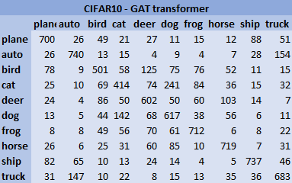
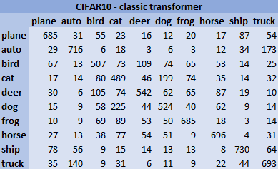
Rezultati: CIFAR10
CIFAR10 - GAT
Loss: | 1.1075
Accuracy: | 0.6525
Precision: | 0.64
Recall: | 0.64
CIFAR10 - classic
Loss: | 1.3144
Accuracy: | 0.6267
Precision: | 0.63
Recall: | 0.63

Slide 9
Problemi I primena

Slide 10
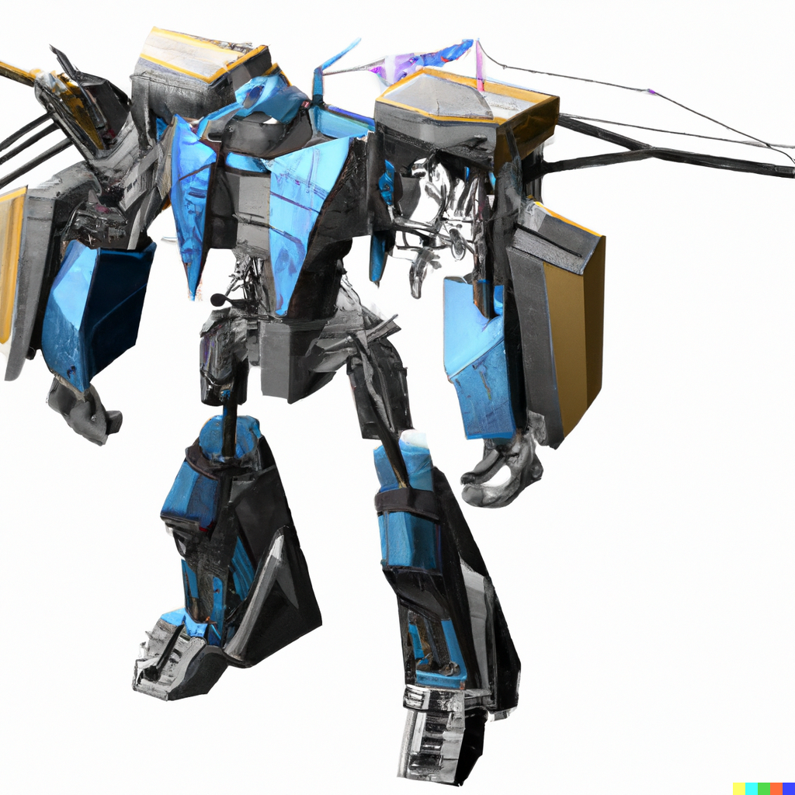
THANK YOU FOR (GNN) ATTENTION

